Slide 1
Raster and Vector Datasets

Slide 2
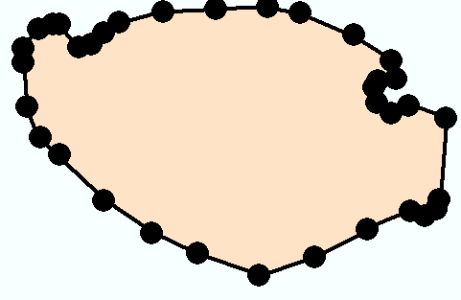
Vector model
Features are stored as a series of x-y coordinates in a rectangular coordinate system.
Many different coordinate systems may be used.
Polygon
Vertices
Line
Points
Nodes
Y
X

Slide 3
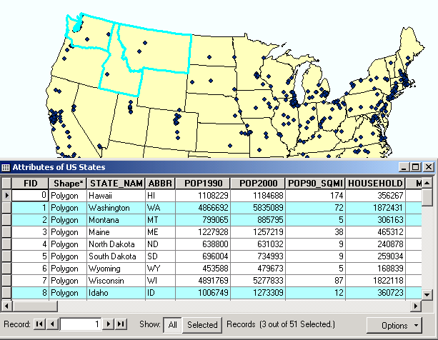
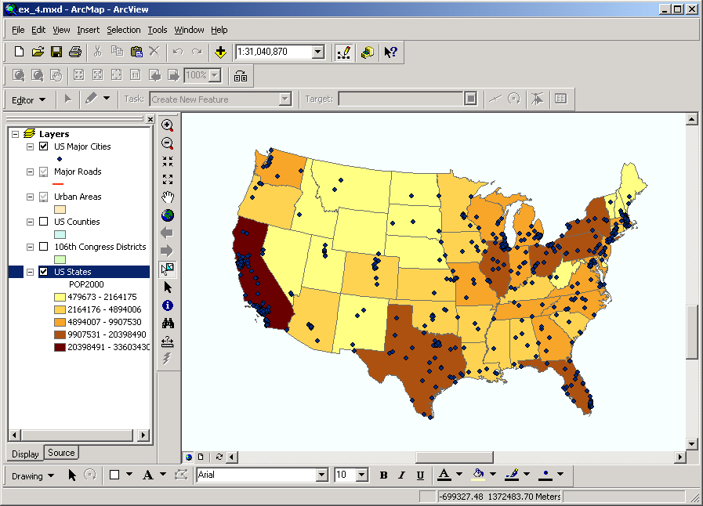
Features linked to data
Each feature is linked to an entry in a data table containing information about the feature.

Slide 4
Advantages of vectors
Precise location of features
Storing many attributes
Flexible for cartography
Compact storage of information
Ideally suited for certain types of analysis, especially areas, lengths, connections

Slide 5
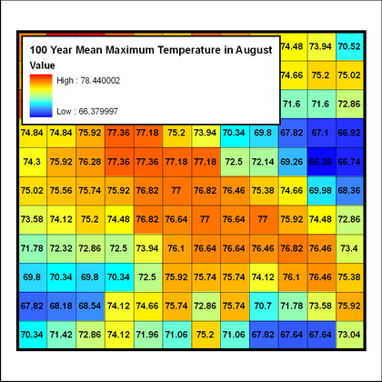
The Raster Data Model
The Raster Data Model is used to model spatial phenomena that vary continuously over a surface and that do not have discrete dimension
Elevation
Temperature
Rainfall
Noise Levels

Slide 6
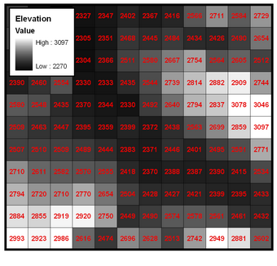
Surfaces Have Numeric Values
Things like elevation, temperature, slope and precipitation have measurable values for any particular location on the earth’s surface.

Slide 7
The raster data model
X, Y location
X, Y location
Columns
Rows
Raster data file
N rows by M columns
Georeferenced to earth’s surface

Slide 8
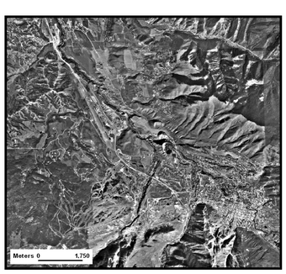
Digital Photos
The most familiar type of Raster Data is the digital photograph.
Digital Photos are raster datasets that record the relative amount of light being reflected off of a surface.

Slide 9
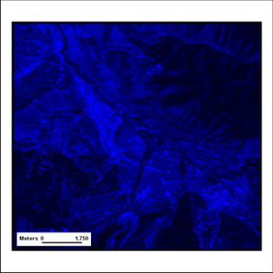
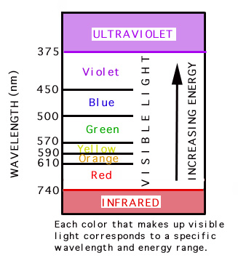
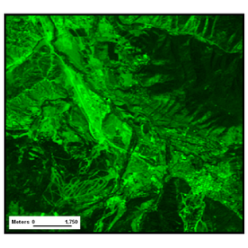
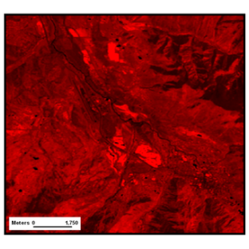
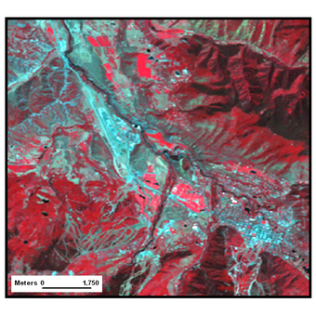
Color Digital Photos
Color Digital Photos are actually made up of three Raster Datasets, each of which describes the amount of reflected Red, Green & Blue light, respectively.
These 3 raster datasets are combines (by the computer) into the R-G-B color image we are used to seeing.

Slide 10
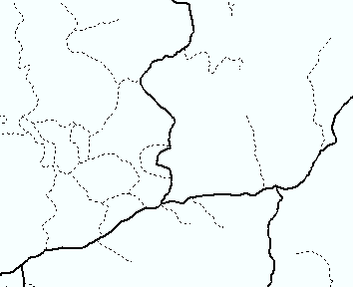
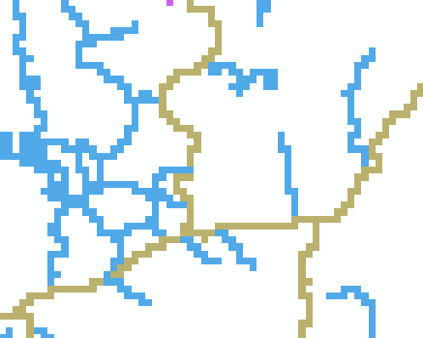
GIS data models
Vector model
Raster model

Slide 11
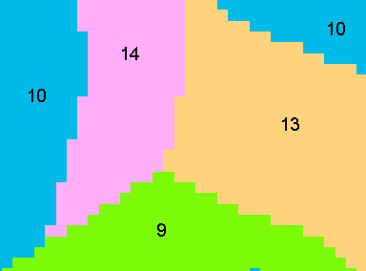
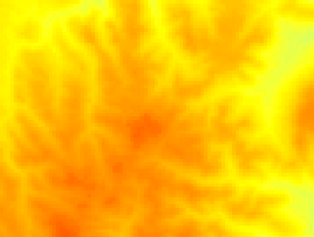
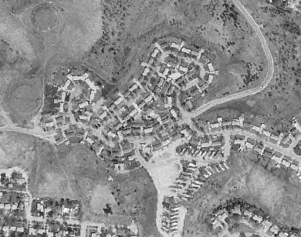
Types of raster data
Discrete raster: land use
Continuous raster: DEM
Continuous raster: image
Discrete raster: roads

Slide 12
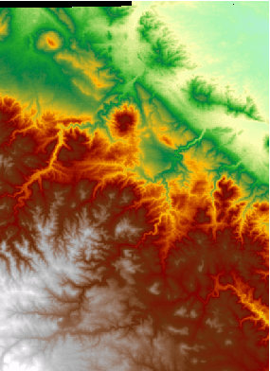
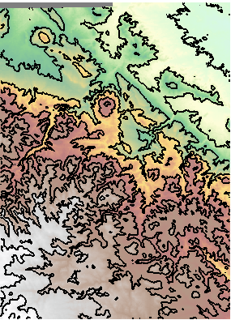
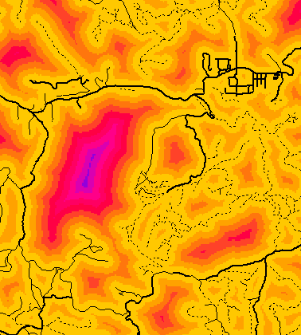
Continuous data
Raster is the best way to store continuously changing values such as elevation
Analysis faster and more flexible than vectors for many applications
Some analysis only possible using rasters

Slide 13
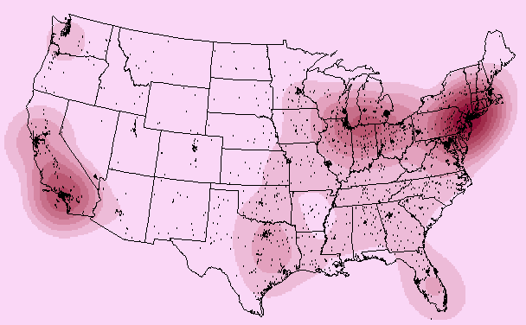
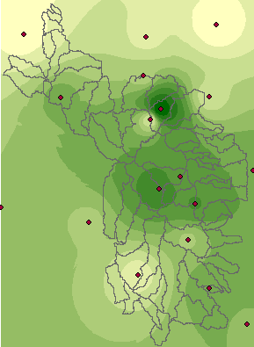
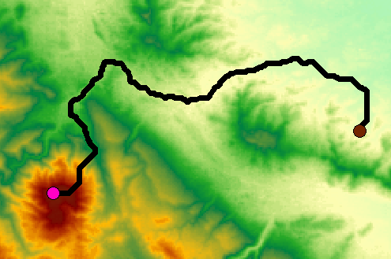
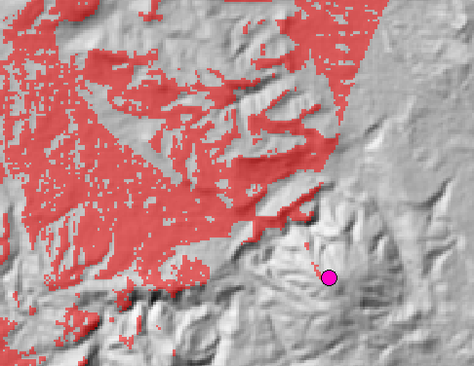
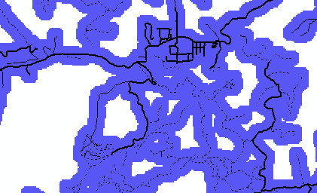
Raster analysis functions
Distance
Interpolation
Density
Least cost path
Viewshed
Buffers

Slide 14
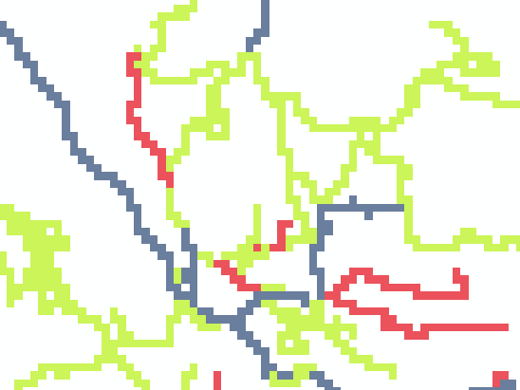
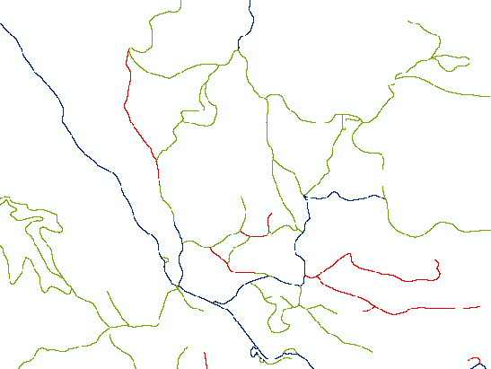
Impact of resolution
90m resolution
Storage space increases by the square of the resolution
Portraying large areas at high precision is problematic
10m resolution

Slide 15
Storage of attributes
Roads may have other attributes: ownership, speed limit, number of lanes, etc.
Would need a new raster for each attribute
Only numeric attributes may be stored
Raster contains 1 value indicating a single attribute—road type for example

Slide 16
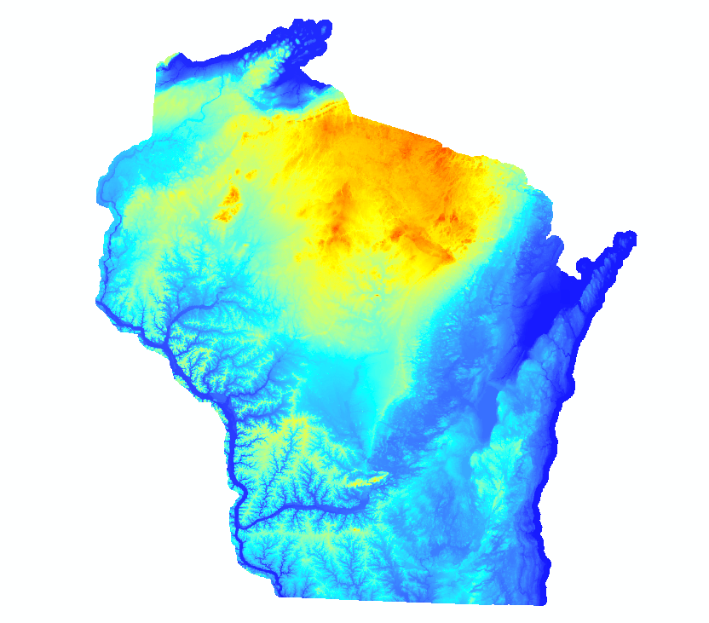

Slide 17
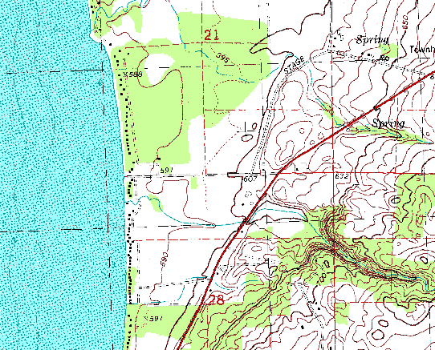
Digital Raster Graphic

Slide 18
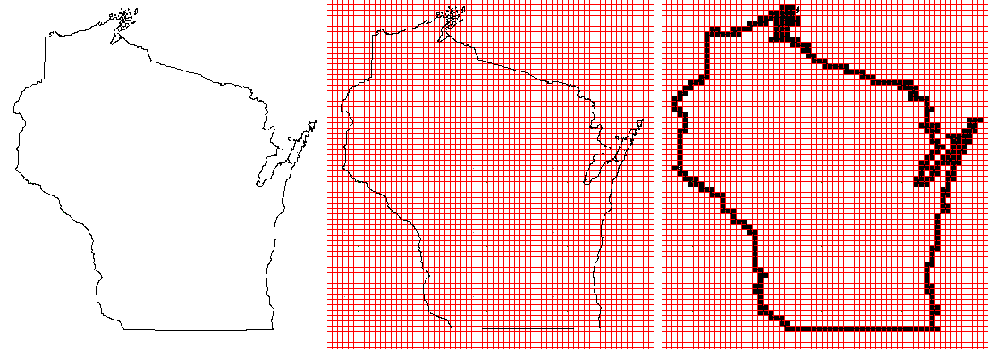
Converting Vector to Raster Data is Easy

Slide 19
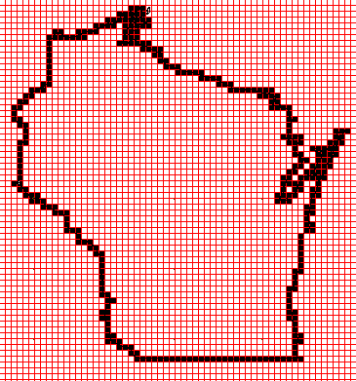
Converting Raster Data to Vector is Hard Nearly Impossible

Slide 20
Take a break for 10 minutes and we will meet again for laboratory work

